Slide 1
THE DIGESTIVE APPARATUS
The avian digestive system is distinguished from that of mammals by the following features:
the beak,
• lack of separation between the oral and pharyngeal
cavities,
• the absence of teeth, lips and cheeks,
• the crop,
• division of the stomach into glandular and muscular
components,
• the presence of two caeca,
• the cloaca.

Slide 3
Oral cavity (cavum oris) and pharynx
The mouth and pharynx of birds having a combined cavity that is surrounded dorsally and ventrally by the beak and called oropharynx.
Beak
The beak varies considerably in shape and is consider a particular avian adaptation for feeding, it also makes a significant contribution during flight as an aerodynamic feature.

Slide 4
The shape of the beak is adapted to the bird’s dietary habits .
A straight, pointed beak is well suited to catching insects as well as gathering seeds and berries. In woodpeckers, the union between the beak and the cranium has shock-absorbing properties.
Flamingos and pelicans(البجع ) have highly specialised beaks. The former use their beak as a filter, placing it upside-down in the water.

Slide 5
chickens, turkeys, quail طائر السمان the beak is pointed and hooked,
whereas in ducks, geese it is flattened into a spoon-like shape .
Roof of the oral cavity
Birds lack a soft palate.
the palate (palatum) forms the dorsal cavities, or oropharynx. An elongated, sometimes oval median cleft (choana) in the palate connects the oropharynx with the left and right nasal cavities ,
The palate is covered by a non-glandular, often keratinised mucosa featuring transverse ridges and shallow grooves.

Slide 6
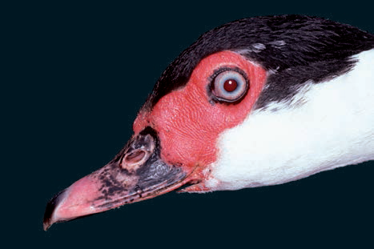
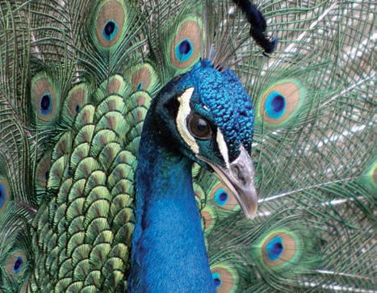
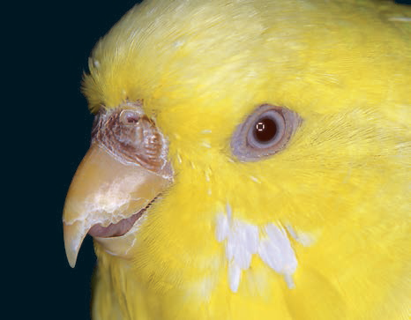
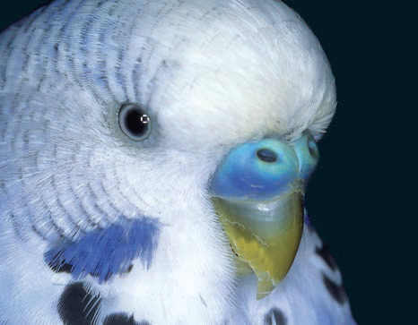
common buzzard
Female budgerigar
Male Indian peafowl
Male budgerigar

Slide 8
Floor of the oral cavity
The shape and development of the avian tongue (lingua) varies markedly, according to diet.
Kolibrdis (الطائر الطنان ) (hummingbirds) and insectivorous birds a very long tongue.
The tongue of psittacines (macaws ببغاء ( a brush-like tip for gathering nectar(لجمع الرحيق ). .
In chickens, a transverse row of caudally directed lingual papillae (papillae linguae) lies between the body and the root of the tongue. In Anatidae (ducks), the caudal third of the tongue is thickened, forming a torus linguae.

Slide 9
Saliva is secreted to moisten food and aid in swallowing since avian species do not have teeth.
Alimentary canal (canalis alimentarius)
The alimentary canal consists of the following components:

Slide 10
oesophagus:
−− crop (ingluvies),
• stomach (gaster):
−− proventriculus (pars glandularis),
−− ventriculus, gizzard (pars muscularis),
• intestine (intestinum):
−− small intestine (intestinum tenue):
• duodenum,
• jejunum,
• ileum,
−− large intestine (intestinum crassum):
• caeca,
• rectum,
• cloaca:
−− coprodeum,
−− urodeum and
−− proctodeum.

Slide 11
Oesophagus
The oesophagus is a flexible, thin-walled tube that extends from the laryngeal mound to the proventriculus.
Its cervical component (pars cervicalis) initially lies dorsal to the trachea.
In the mid to lower cervical region, both the oesophagus and the trachea pass to the right side of the neck.

Slide 14
At the thoracic inlet, the oesophagus widens to form the crop that, in most species, lies ventrally. and passes along the ventral aspect of the lungs and over the base of the heart. At the level of the third to fourth intercostal space, the oesophagus opens into the proventriculus.
At the thoracic region of the body cavity, the
oesophagus is surrounded by components of the cervical, clavicular and cranial thoracic air sacs.

Slide 15
Crop
The crop is formed by the dilation of the oesophagus immediately before its entry into the body cavity.
Function :it permits temporary storage of ingesta as well as softening and pre digestion
foodstuffs. Particularly in granivores, the crop is capable of considerable expansion.
The structure of the crop wall is similar to that of the oesophagus (). It contains mucous crop
glands (glandulae ingluviales) similar to those found in the oesophagus

Slide 16
Stomach (gaster)
There are three basic types of avian stomach, reflecting
the diet of different species:
In seagulls and storks(طيور النورس واللقالق ), which quickly ingest large quantities of animal protein, the stomach is a highly expandable, single sac-like structure with little muscle development.
The stomach of grain- and plant-eating species, including the chicken, pigeon, goose and duck, is clearly divided into two compartments, the glandular proventriculus and the muscular ventriculus (Figures 6.17ff.).
In fruit-eating species,
such as tanagers (fruit-eating omnivores), the stomach
is reduced to a rudimentary diverticulum.

Slide 17
The proventriculus continues from the oesophagus without a clear anatomical boundary.
The proventriculus is spindle shape located in a pouch of the intestinal peritoneal sac. In
most species, the mucosa is arranged in folds that, in the chicken, lie on prominent papillae .

Slide 18
The isthmus is the transition from the glandularm stomach to the muscular gizzard. It has no glands in its thinner, less rigid wall.
The ventriculus or gizzard is lens-shaped in herbivores, poultry, and waterfowl and is positioned with its convex surfaces facing more or less to right and left. Its interior is elongated, enlarged by cranial and caudal blind sacs, of which the former connects with the proventriculus.
The duodenum arises on the right surface, adjacent to the cranial blind sac. The mucous membrane is thin but very tough; bounded by a cuboidal epithelium, it largely consists of tubular glands, whose secretion solidifies on the surface. It forms, catalyzed by the low pH due to the hydrochloric acid from the proventriculus.

Slide 19
Intestine
The intestines occupy the caudal part of the body cavity, . They consist of duodenum, jejunum, ileum, and colon that open into the cloaca. In herbivorous birds there also two ceca that arise from the ileocolic junction and accompany the ileum in retrograde fashion (Figure 37–20).
The pancreas lies between the limbs and
empties into the distal end of the ascending duodenum;
The jejunum forms loose coils along the edge of the
mesentery and is so thin walled that its content causes
it to appear greenish

Slide 21
In the duck and goose, the jejunum is arranged in several U-shaped loops; in the
pigeon, it forms a cone-shaped mass with outer centripetal and inner centrifugal turns. In insect- and fruiteating birds the jejunum is very short and wide.
The ileum continues from the jejunum without
demarcation. It is variably described beginning at the vitelline diverticulum or opposite the apices of the ceca .

Slide 22
The large intestine comprises the ceca and the colon
. The ceca, relatively long in the chicken and the turkey, arise at the ileocolic junction and pursue retrograde courses beside the ileum to which they are attached by ileocecal folds. They pass cranially their blind ends usually lie near the cloaca .

Slide 23
The (colo)rectum is about 10 cm long in chickens and ends by a slight enlargement at the cloaca. The colo rectum is no thicker than the small intestine and reabsorbs water and electrolytes by antiperistaltic movements. Urine is moved from the cloaca into the colorectum by antiperistalsis.

Slide 24
The cloaca, common to the digestive and urogenital
systems, opens to the exterior at the vent .The cloaca is
divided sequentially into coprodeum, urodeum, and
proctodeum by two more or less complete annular folds.

Slide 25
The avian liver is dark brown (except in the first 2 weeks after hatching when it obtains a yellow color from yolk pigments, which continue to be absorbed from the intestine before the yolk sac finally regresses). It consists of right and left lobes, connected cranially by a bridge dorsal to the heart (Figure 37–16). The larger right lobe carries the gallbladder on its visceral surface and is perforated by the caudal vena cava; the left lobe is divided .The convex parietal surface lies against the

Slide 26
sternal ribs and sternum and is exposed The liver is covered by a peritoneal sac that can contain much fat; in certain diseases it fills with transudate. The concave visceral surface makes contact with the spleen, proventriculus, gizzard, duodenum, jejunum, and ovary (or right testis). The duct from the right lobe is connected to the gallbladder.
Pigeons, , budgerigars, lack a gallbladder.
The elongated pancreas lies between the limbs of the
duodenal loop (Figure 37–20/2,2′). It consists of dorsal
and ventral lobes distally connected. Two or three ducts convey pancreatic juice into the distal end of the
duodenum.

Slide 27
Spleen
The spleen is mentioned here because
of its relationship to the stomach and liver . It is a brownish-red sphere, about 2 cm in diameter,
and lies in the median plane beside the proventriculus.
The spleen is triangular in the duck and goose, oval inthe pigeon, round and elongated in forms .

